Slide 1

Mini Project-I (K24MCA18P) Odd Semester Session 2024-25
PATH FINDING VISUALIZER
Nikita Agarwal 2426MCA686
Poornima 2426MCA1383
Priyanshi 2426MCA2589
Project Supervisor:
Mrs. Divya Singhal

Slide 2
Content
Introduction (1 slide)
Literature Review (2 slides)
Objective of the Project (1 slide)
Technology
Hardware Requirements (Development Environment, Server requirement (if required), Client requirement (if required).
Software Requirements (Language and Platforms like Frameworks, VS code, Android Studio and Jupyter notebook etc. )
Modules (2-3 slides)
Workflow (1 slide)
Reports
References (1 slide)
Notes:
Font Styles: Times New Roman + Font Size: 25

Slide 3
Introduction
The Pathfinder Visualizer project is designed to illustrate and analyze pathfinding algorithms in a visual format to find the shortest path.
It brief particularly about a path connecting two locations. Being more a useful maze-solving variation.
A pathfinding method searches at its core. Usually with the aim of finding the least expensive path, one starts at one vertex in a graph and searches through neighbouring nodes until reaching the destination node.
It helps users understand how algorithms like A*, Dijkstra's, or Breadth-First Search work by showing the process of finding the shortest path in a grid or maze.
Notes:
Font Styles: Times New Roman + Font Size: 25

Slide 4
Literature Review
The literature review of path finding visualizer concentrate on various important topics, such as algorithms, visualisation methods, and teaching aids for computer science concepts.
Pathfinding is widely used in areas such as robotics, game development, network routing, and AI, and involves algorithms that search for the shortest or most efficient route between two points.
Pathfinding algorithms are essential in various applications like autonomous navigation, AI game agents, and graph-based computations.
Key algorithms like A*, Dijkstra's, BFS, and DFS are essential for navigation in robotics, gaming, and networking.
Tools like VisuAlgo and Pathfinding Visualizer enhance understanding by visually demonstrating algorithms in action.
Notes:
Font Styles: Times New Roman + Font Size: 25

Slide 5
Literature Review (Contd.)
Interactive visualizers improve comprehension and retention of algorithm concepts among students.
Successful integration in educational settings has led to better student engagement and performance.
Effective design and real-time feedback are crucial for engaging users and facilitating learning.
Ongoing issues include performance and scalability, with potential advancements in VR and AR for enhanced learning experiences.
Pathfinding visualizers play a vital role in making complex algorithms accessible and understandable, highlighting the need for continued development in this area.
Notes:
Font Styles: Times New Roman + Font Size: 25

Slide 6
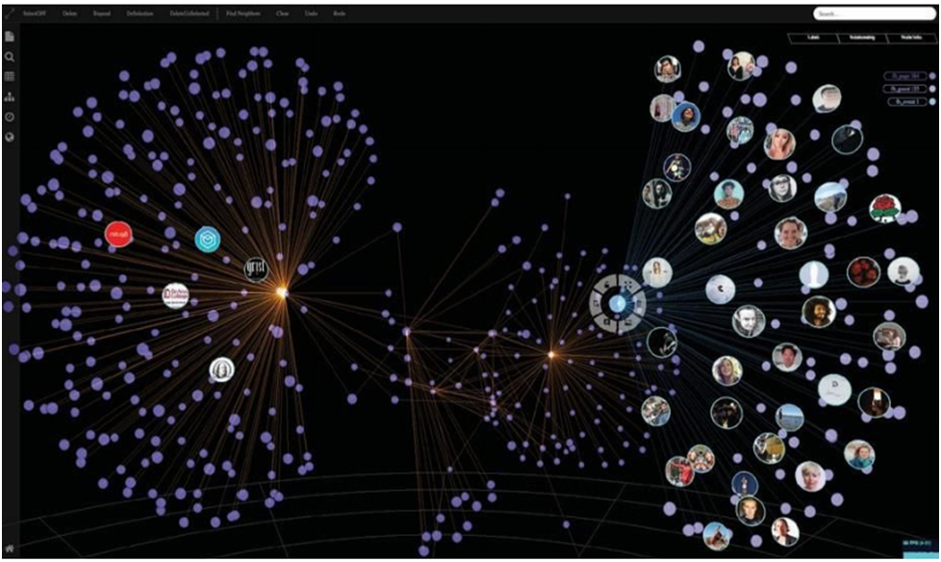
Objective of the Project
Visualize Algorithm Behavior: Show how different pathfinding algorithms traverse a grid or map.
Identify Optimal Paths: Show how the algorithms find the shortest or most efficient path from start to finish.
Educational Tool: Provide an interactive way to learn how pathfinding algorithms work.
Real-Time Simulation: Demonstrate the step-by-step decision-making process of the algorithms.
Explore Heuristics: Allow users to see how different heuristics impact algorithm performance.
Notes:
Font Styles: Times New Roman + Font Size: 25

Slide 7
Technology (Hardware Requirements)
Minimum System Requirements :-
Memory: 4 GB
Graphics Card: Not Compulsory
CPU: Intel Core 2 duo and Apple Silicon
File Size: 3 GB
OS: Windows 10 and Mac OS
Notes:
Font Styles: Times New Roman + Font Size: 25

Slide 8
Technology (Software Requirements)
Minimum Software Requirements :-
Visual Studio Code
Python
HTML, CSS
Javascript
Pygame Module
Notes:
Font Styles: Times New Roman + Font Size: 25

Slide 9
Modules
Pathfinding Algorithms Module:
Purpose: Implements the pathfinding algorithms (e.g., A*, Dijkstra, BFS, DFS).
Responsibilities:
Process the grid to find the shortest path.
Return the list of nodes that form the path.
Grid Module:
Purpose: Manages the grid where the pathfinding occurs.
Responsibilities:
Create and display the grid (nodes or cells).
Track the state of each node (e.g., start, end, wall, empty, visited).
Handle mouse interactions to place walls, set start and end points.
Notes:
Font Styles: Times New Roman + Font Size: 25

Slide 10
Modules (Contd.)
Node Module:
Purpose: Represents each cell or node in the grid.
Responsibilities:
Store the node's position, neighbors, and state (start, end, wall, etc.).
Track if the node has been visited or is part of the current path.
HTML & CSS Module:
Purpose: Sets up the layout and styles of the pathfinding visualizer in a single module.
Responsibilities:
Create the main structure, including the grid, buttons, and algorithm selector, using semantic HTML elements.
Define styles for the layout and appearance of the grid and cells, including colors, margins, and hover effects.
Style buttons and headers for a user-friendly interface, ensuring visual feedback for different cell states (walls, paths).
Notes:
Font Styles: Times New Roman + Font Size: 25

Slide 11
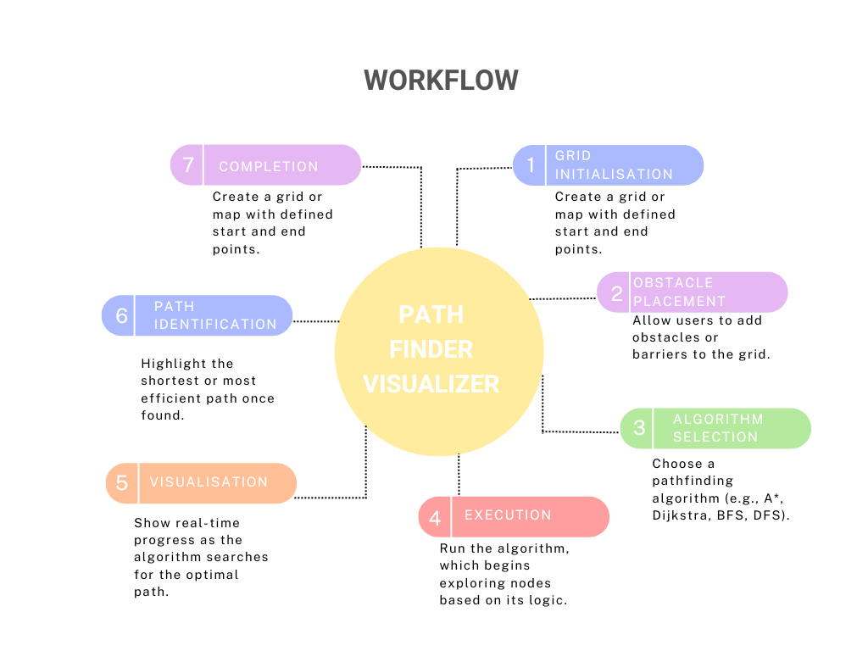
Workflow
Notes:
Font Styles: Times New Roman + Font Size: 25

Slide 12
Reports
Goal:
For both practical and instructional purposes, different pathfinding algorithms (DFS, A*, Dijkstra's, and BFS) are visualised.
Specification:
Interface: Interactive grid featuring controls for obstacle addition and algorithm start/stop.
Visualisation: Obstacles, paths, and open/closed areas are coloured.
Customisation: Grid size and algorithm selection options.
Application:
Built using [insert technologies, such as HTML and JavaScript].
Performance:
Effective at visualising various algorithms of various complexity levels.
Conclusion:
With room for improvement, the visualiser provides an effective demonstration of pathfinding algorithms.
Notes:
Font Styles: Times New Roman + Font Size: 25

Slide 13
References
https://youtu.be/msttfIHHkak?feature=shared
https://pathfindout.com/
https://en.wikipedia.org/wiki/Pathfinding#:~:text=remove%20this%20message
https://www.researchgate.net/publication/364343320_Path_Finding_Algorithm_Visualization
Notes:
Font Styles: Times New Roman + Font Size: 25

